Slide 1


From nothing to full AI applications with Semantic Kernel in .NET 9
Global AI Bootcamp 2025 Bangkok
Emiliano Montesdeoca del Puerto
Microsoft MVP in Developer Technologies
Cloud Dev Team Lead @ Intelequia
@emimontesdeocaa
blog.emilianomontesdeoca.com

Slide 2

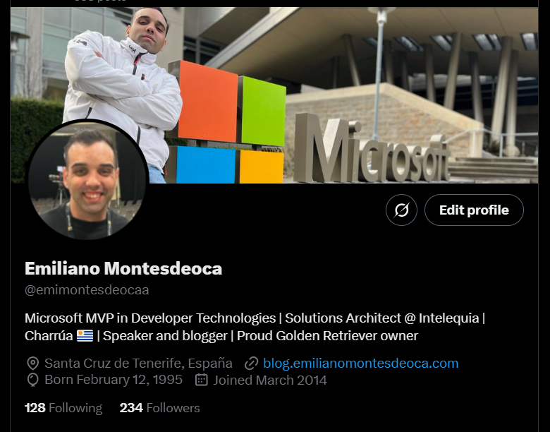
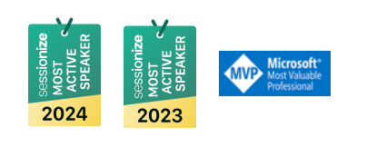

You can call me Emi
Uruguayan
Microsoft MVP
Cloud Dev Team Lead
@emimontesdeocaa
Global AI Bootcamp 2025 Bangkok
@emimontesdeocaa
Notes:
My name is [Speaker name], [Speaker title] at [Speaker company] .
My name is [Speaker name], [Speaker title] at [Speaker company] .

Slide 3
How do I make my dumb app smart?
Your boss would tell you that…
Global AI Bootcamp 2025 Bangkok
@emimontesdeocaa
Notes:
This is just another example of a phrase being transformed into tokens.
Here we can specifically see the number translation of tokens also known as vector embeddings.
You can explore how the tokenizer works more at…. Platform.openai.com/tokenizer

Slide 4
How are our apps today?
Robotic interactions
Fixed code
No natural intelligence
Any change is complex
It costs money
Global AI Bootcamp 2025 Bangkok
@emimontesdeocaa
Notes:
Ok, so before we dive into the workshop I am going to quickly go over how language models work and breakdown how we can interact with them to change their output.
For a typical text generation model if we look at the image we can see they….
Receive natural language input
That input is then turned into tokens which the individual tokens are depicted by the different coloured boxes in the image
The tokens are then transformed into numbers for the model to process
The model interprets the numbers and outputs a probability distribution (a list), of the next likely tokens
The model then samples (selects) from the distribution (list), to generate the final natural language output

Slide 5
How should they apps be?
“Human” interactions
Personalized experience
Our data and our logic
Keeps improving
Easy to use
Global AI Bootcamp 2025 Bangkok
@emimontesdeocaa
Notes:
Ok, so before we dive into the workshop I am going to quickly go over how language models work and breakdown how we can interact with them to change their output.
For a typical text generation model if we look at the image we can see they….
Receive natural language input
That input is then turned into tokens which the individual tokens are depicted by the different coloured boxes in the image
The tokens are then transformed into numbers for the model to process
The model interprets the numbers and outputs a probability distribution (a list), of the next likely tokens
The model then samples (selects) from the distribution (list), to generate the final natural language output

Slide 6

Semantic Kernel
AI for you made easy!
Global AI Bootcamp 2025 Bangkok
@emimontesdeocaa
Notes:
This is just another example of a phrase being transformed into tokens.
Here we can specifically see the number translation of tokens also known as vector embeddings.
You can explore how the tokenizer works more at…. Platform.openai.com/tokenizer

Slide 7
What is Semantic Kernel?
Semantic Kernel is a lightweight, open-source development kit that lets you easily build AI agents and integrate the latest AI models into your C#, Python, or Java codebase. It serves as an efficient middleware that enables rapid delivery of enterprise-grade solutions.
Global AI Bootcamp 2025 Bangkok
@emimontesdeocaa
Notes:
Ok, so before we dive into the workshop I am going to quickly go over how language models work and breakdown how we can interact with them to change their output.
For a typical text generation model if we look at the image we can see they….
Receive natural language input
That input is then turned into tokens which the individual tokens are depicted by the different coloured boxes in the image
The tokens are then transformed into numbers for the model to process
The model interprets the numbers and outputs a probability distribution (a list), of the next likely tokens
The model then samples (selects) from the distribution (list), to generate the final natural language output

Slide 8
Kernel?
The kernel is the central component of Semantic Kernel. At its simplest, the kernel is a Dependency Injection container that manages all of the services and plugins necessary to run your AI application. If you provide all of your services and plugins to the kernel, they will then be seamlessly used by the AI as needed.
Global AI Bootcamp 2025 Bangkok
@emimontesdeocaa
Notes:
Ok, so before we dive into the workshop I am going to quickly go over how language models work and breakdown how we can interact with them to change their output.
For a typical text generation model if we look at the image we can see they….
Receive natural language input
That input is then turned into tokens which the individual tokens are depicted by the different coloured boxes in the image
The tokens are then transformed into numbers for the model to process
The model interprets the numbers and outputs a probability distribution (a list), of the next likely tokens
The model then samples (selects) from the distribution (list), to generate the final natural language output

Slide 9
Let’s do some code!
That’s why you’re here…. Right?
Global AI Bootcamp 2025 Bangkok
@emimontesdeocaa
Notes:
This is just another example of a phrase being transformed into tokens.
Here we can specifically see the number translation of tokens also known as vector embeddings.
You can explore how the tokenizer works more at…. Platform.openai.com/tokenizer

Slide 10
Thanks!
@emimontesdeocaa
https://github.com/emimontesdeoca/global-ai-2025-colombia-health
Global AI Bootcamp 2025 Bangkok
@emimontesdeocaa
Notes:
This is just another example of a phrase being transformed into tokens.
Here we can specifically see the number translation of tokens also known as vector embeddings.
You can explore how the tokenizer works more at…. Platform.openai.com/tokenizer

